Slide 1
Welcome to DCHS Band
2023-2024 Band Parent Meeting
This presentation will be available on the band website – DCHSBand.org
New* Everyone will be signed up on the website for “Email Blast”, to receive band/booster communications

Slide 2
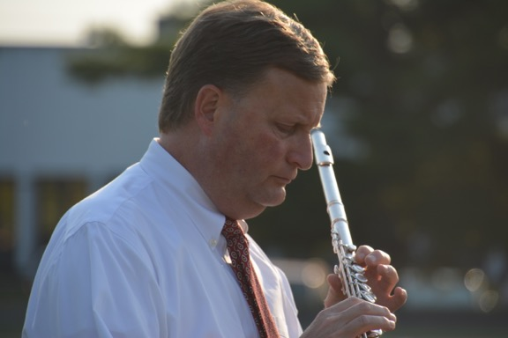
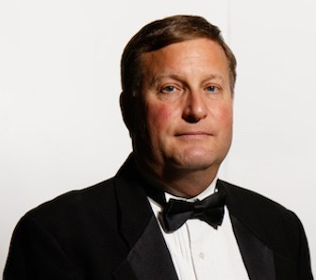
Mr. Stephen Holland
Director of Bands
35th year at Dowling Catholic
11-12 Symphony Band
Pep Bands
Jazz Ensemble, Jazz II
Various Chamber Groups

Slide 3
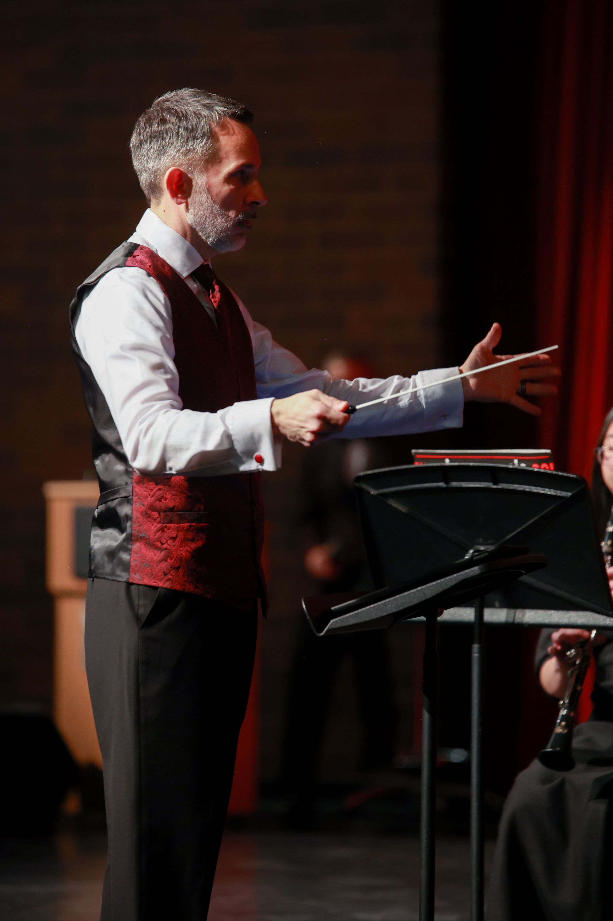
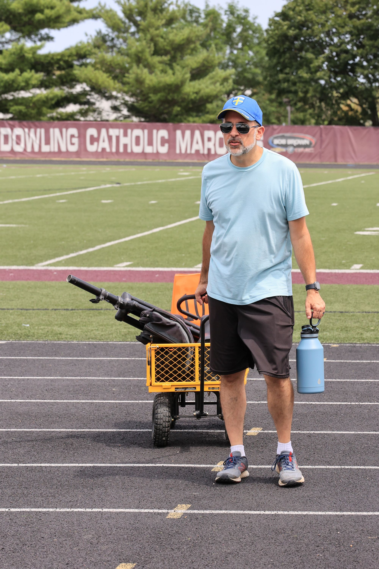
Mr. Nicholas Hoover
Assistant Director of Bands
20th year at Dowling Catholic
Vanguard (DCV)
9-10 Concert Band
Percussion Methods
Music History and Music Theory
Pit Orchestra for Dowling’s Spring Musical
Various Chamber Groups

Slide 4
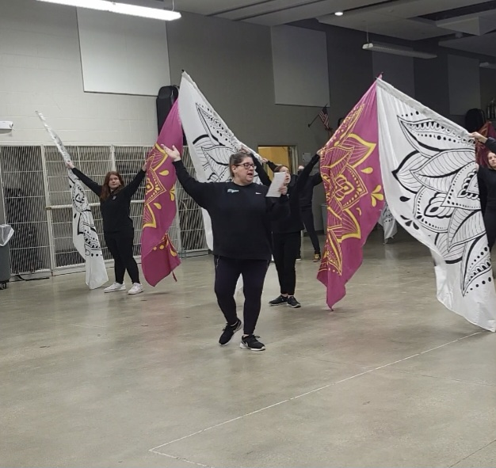
Coach Angie Countryman-Marcantel
Colorguard & Winterguard Director
21st Year at Dowling Catholic
Coaching, designing, choreographing, judging Iowa color guards for 30 years
Co-founded/Executive Director for Studio Tucee’ Winter Guard who competed on the Winterguard International (WGI) level - 2000-2003

Slide 5
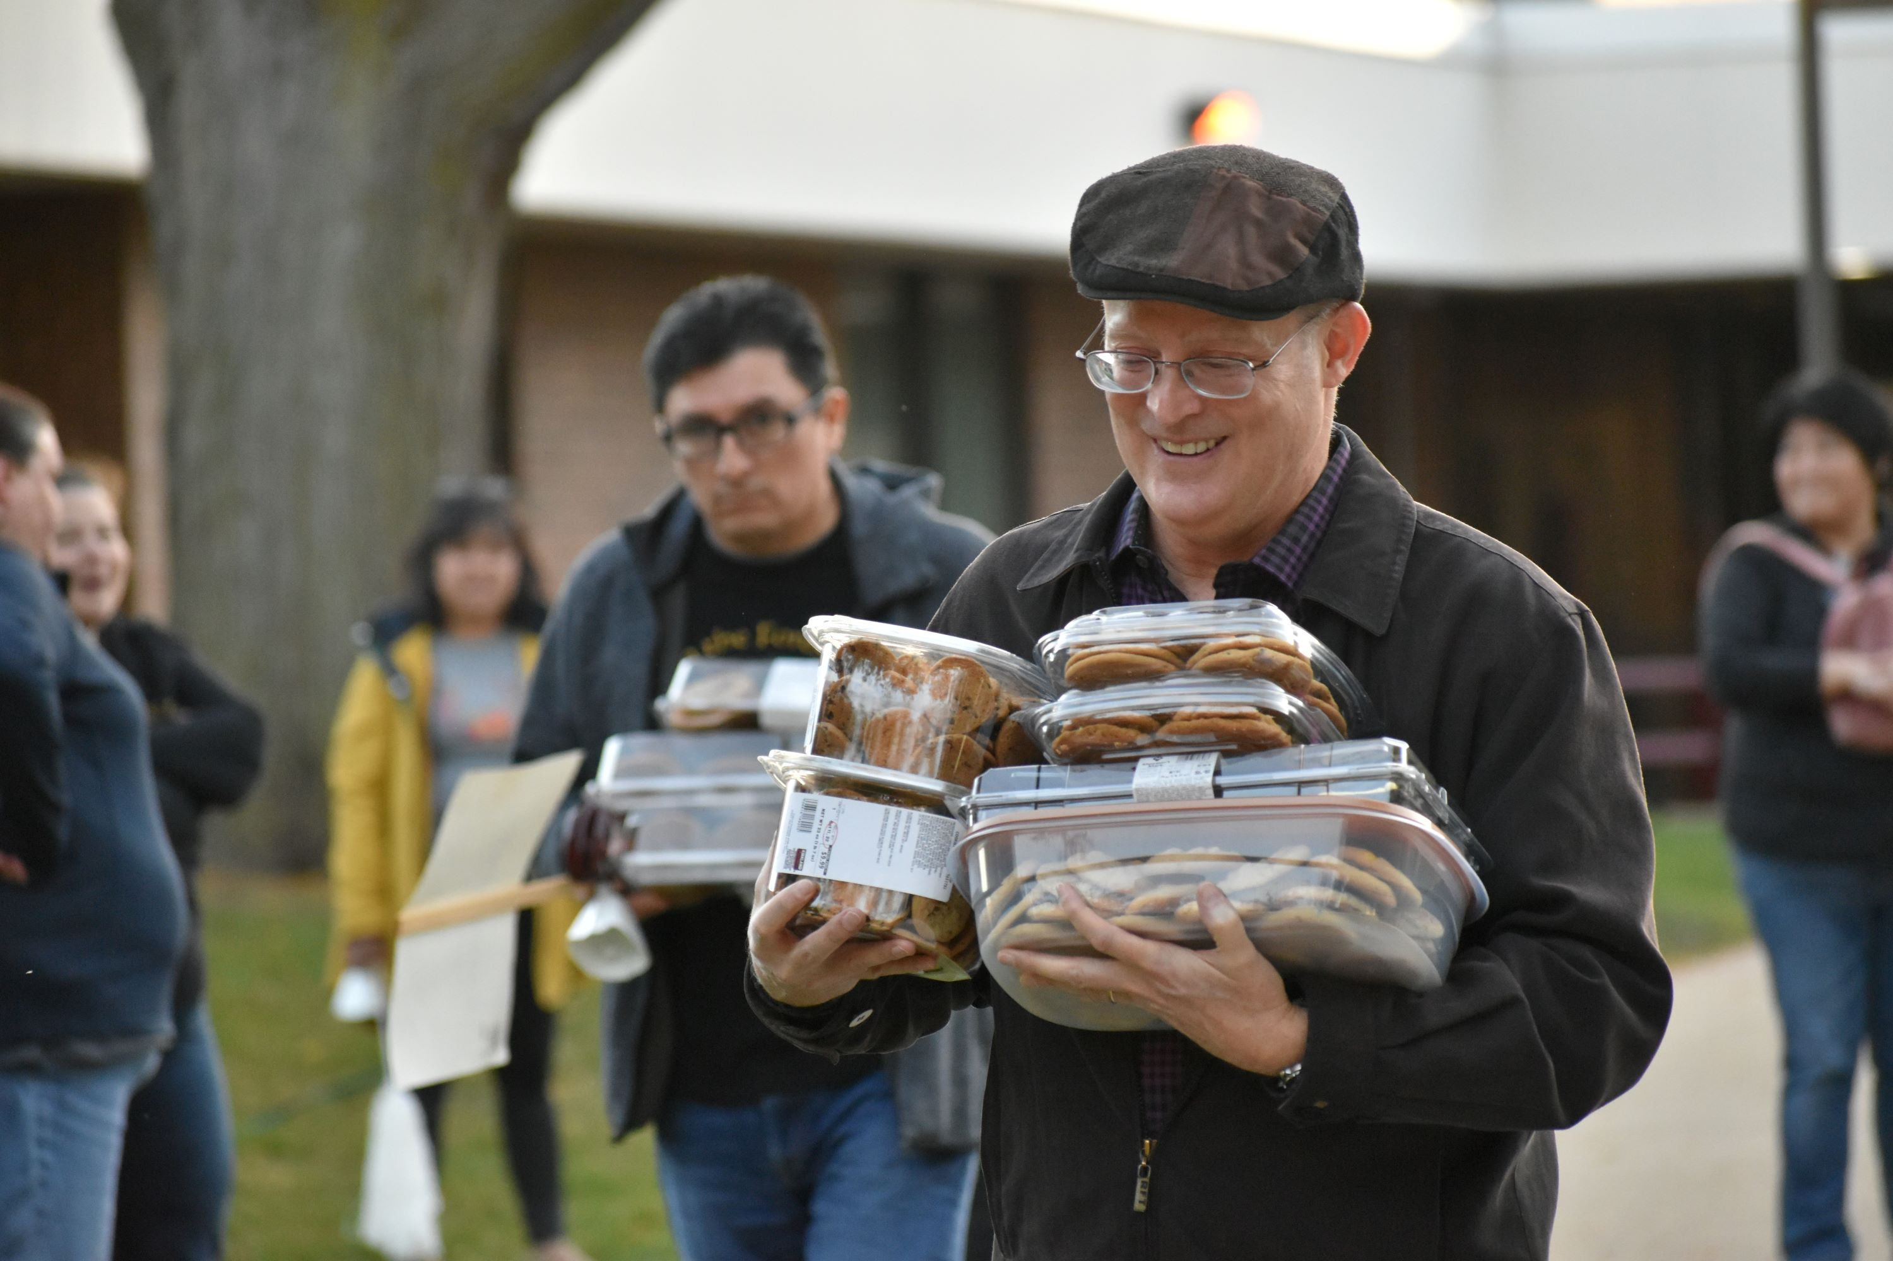
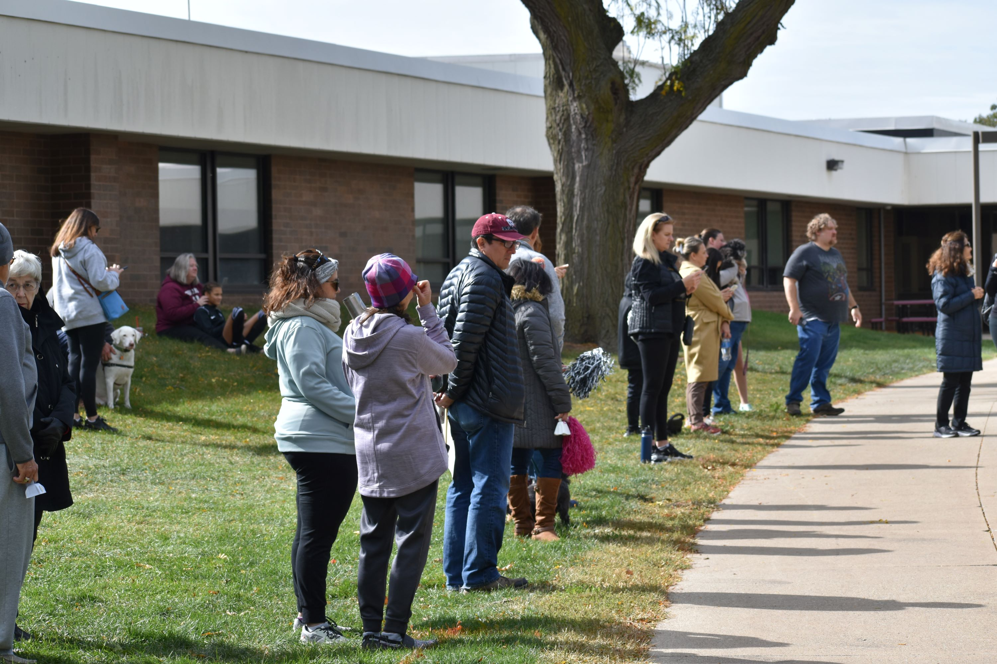
Dowling Catholic Band Boosters
As a parent of a band student, you are automatically a member of the Band Boosters
Parent-run organization
Mission is to assist and support the Dowling Catholic Band Program and its Directors, staff, and students
Being an active member of the Band Boosters is a great way to meet other parents and form new friendships!!

Slide 6
Dowling Catholic Band Boosters
2022-2023 2023-2024
President: Leenie Rodriguez Leenie Rodriguez (Interim)
Vice President: Suzie Fenton Denise Davies
Secretary: Mary Dietrich Steve Van Brocklin
Treasurer: Troy Lewis Troy Lewis
Colorguard Representative: Laurel Kruse TBD

Slide 7
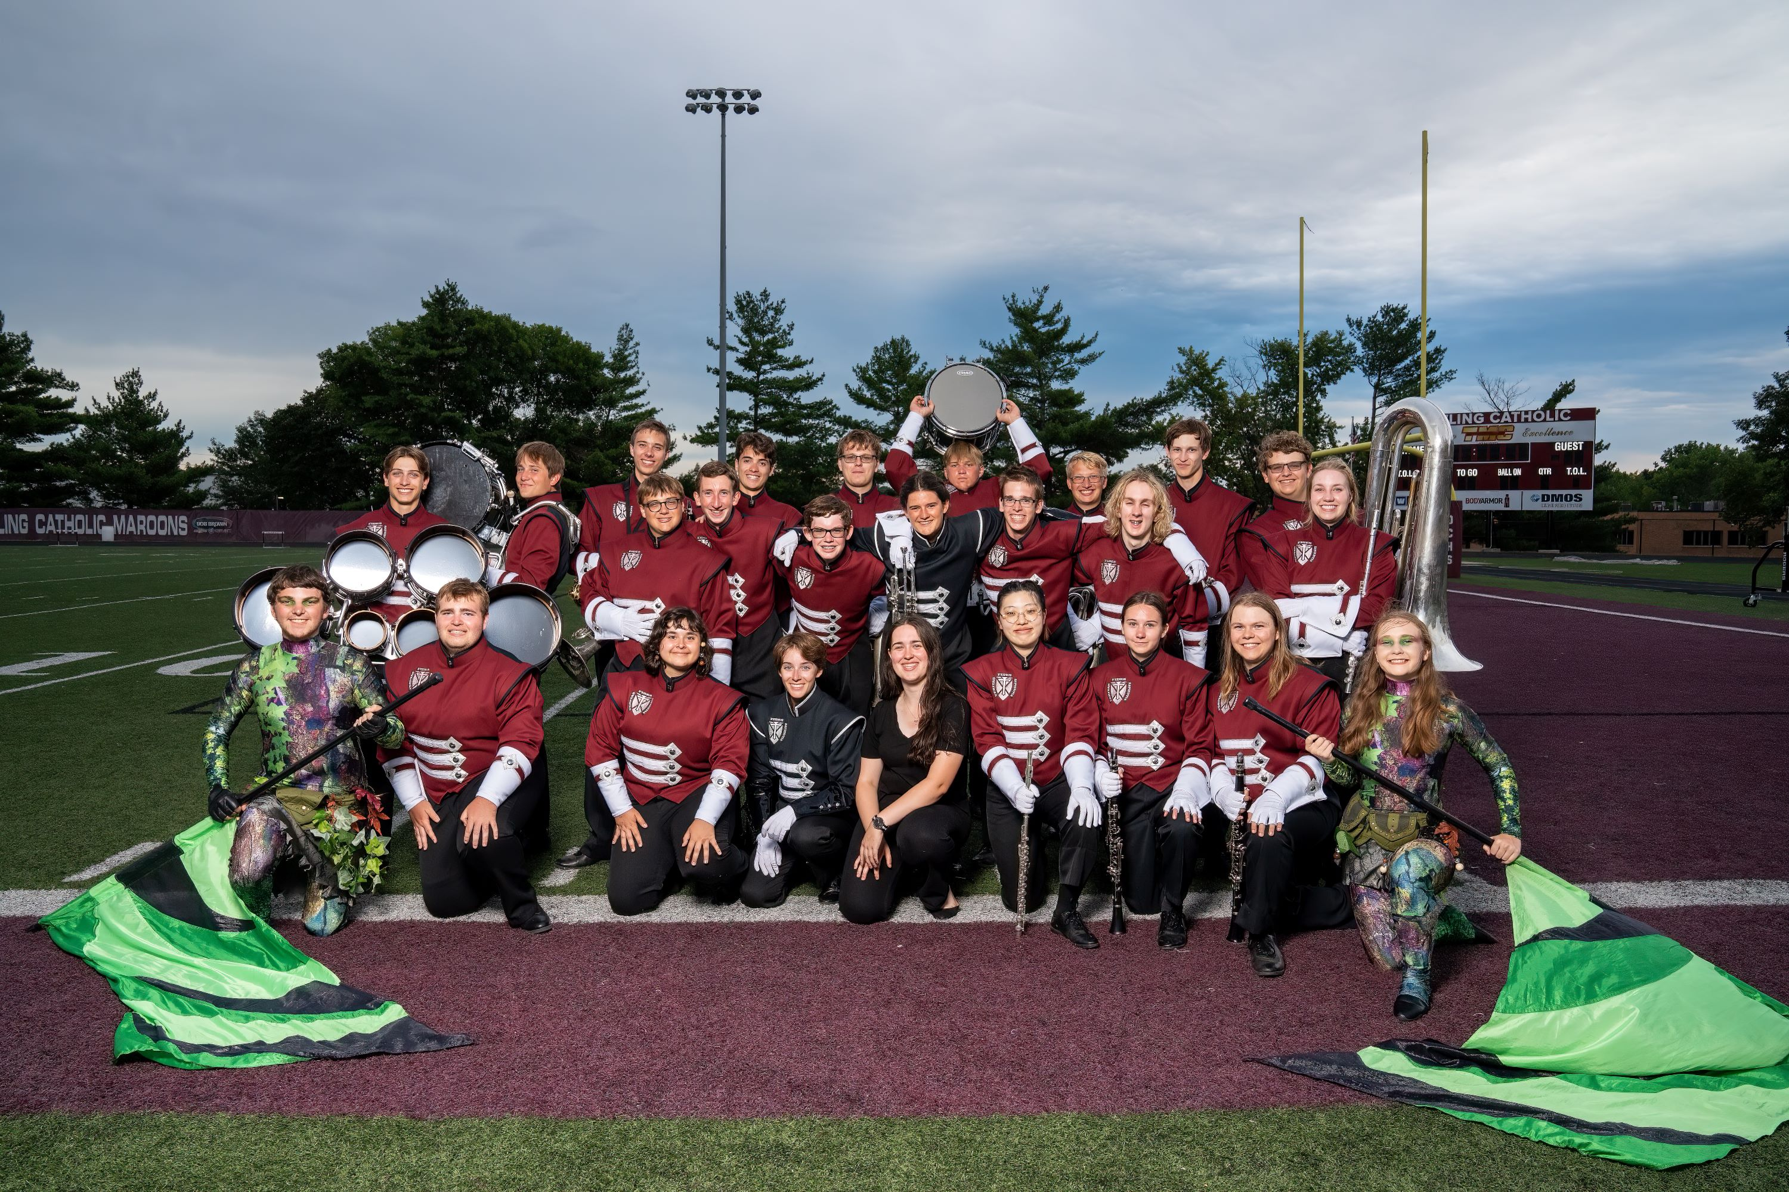
Our Different Bands
Dowling Catholic Vanguard (DCV)
Summer to mid-October
Marching Band + Colorguard
All Students
Percussion
Battery = Marches on field
Pit = Stationary; at the front
Pep Band
Football/basketball season
All Wind + Percussion
Divided into Pep Band A & Pep Band B
Perform at football playoff games and select basketball games
2-3 required performances to be assigned
Notes:
Hoover

Slide 8
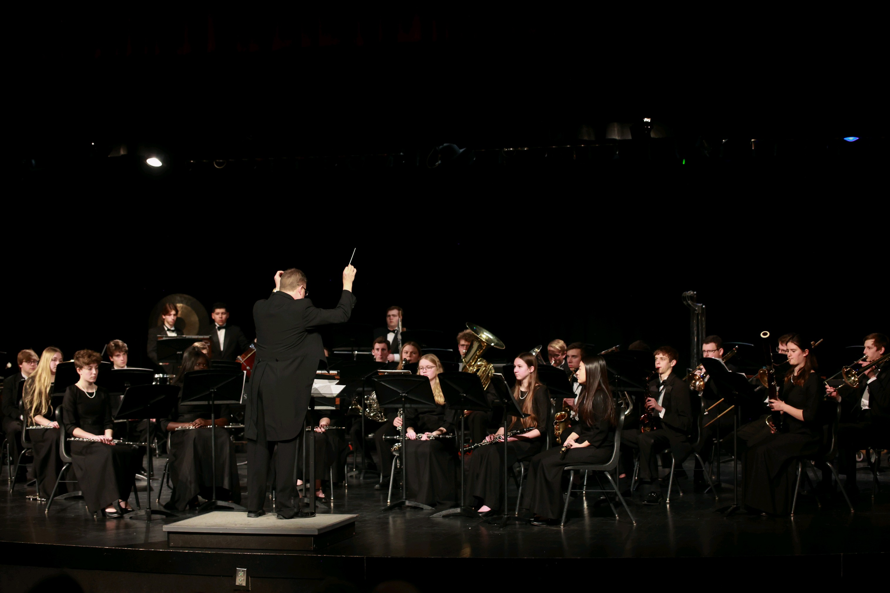
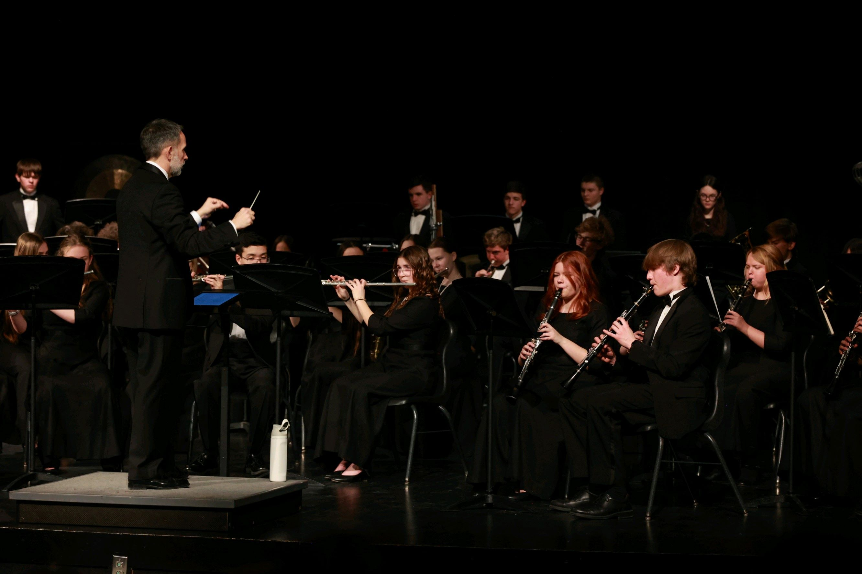
Our Different Bands
Symphony Band
Mid-October to end of school year
1st period
Juniors and Seniors
Directed by Mr. Holland
Concert Band
Mid-October to end of school year
1st period, then 5th period (2nd semester)
Freshmen and Sophomores
Directed by Mr. Hoover
Notes:
Hoover

Slide 9
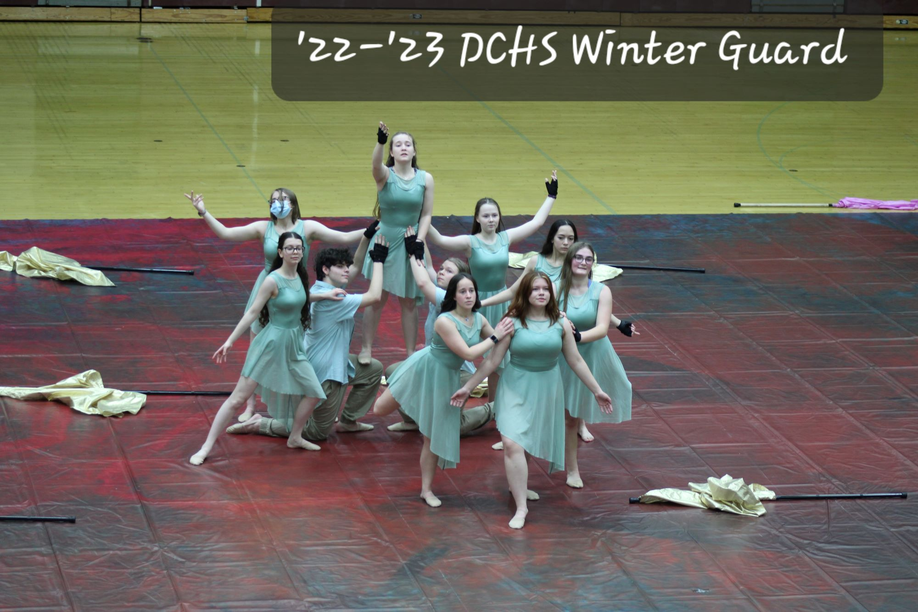
Colorguard
Nonmusical section of Vanguard
Interprets the music via dance and synchronized spinning of flags, sabers, rifles and other pieces of equipment
Winterguard
Performs to recorded music at halftime of basketball games
Performs at competitions
Tryouts are held in the Spring
All students, male or female, are encouraged to participate
Notes:
Hoover

Slide 10
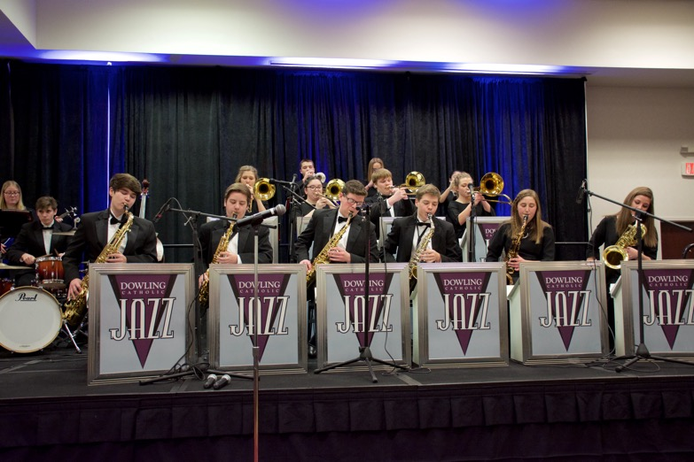
Jazz Bands & Chamber Ensembles
Jazz Bands (optional)
Downtown Swing Project – Selection Only
Jazz Ensemble – Auditioned in spring
Jazz II – Auditioned in spring
Chamber Ensembles (optional)
Brass Choir
Clarinet Choir
Flute Choir
Pit Orchestra for Spring Musical
Sax Choir
* Check the Google Calendar for rehearsal times!!
Notes:
Holland

Slide 11
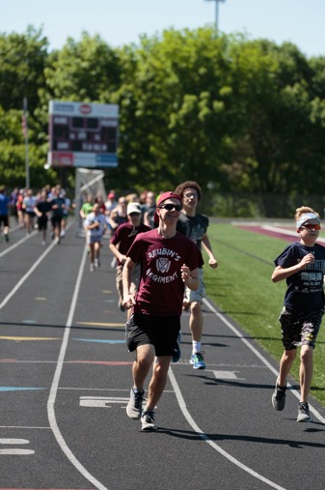
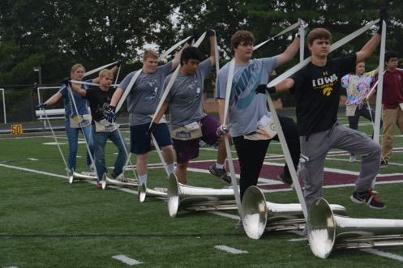
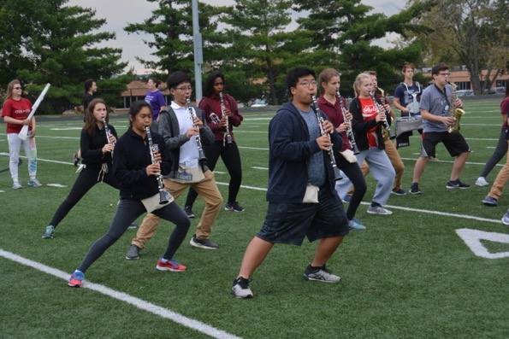
School Year Rehearsals
Vanguard
A Days – Zero Hour + 1st Period (7 a.m. – 9:30 a.m.)
B Days – Zero Hour (7 a.m. – 8 a.m.)
After the first few weeks only A days
Concert Band (after marching season)
1st Period – First semester
5th Period – Second semester
Symphony Band (after marching season)
1st Period – Both semesters
“Zero Hour” = 60-90 minutes before school starts

Slide 12
SmartMusic
Web-based program; primary practice tool
Already paid for– access code provided
Students need to register using their Dowling address
Accessed by any electronic device
Typically students use Chromebooks, but can also use computers, laptops, tablets
Music assigned as homework / Final Exam
While a student plays or practices at home, SmartMusic scores the student based on accuracy
Submitted to Band Director for grading
Doesn’t apply to Percussion

Slide 13
Band Lessons
Private lessons (strongly recommended)
Outside of school
Private Lesson teacher must be a specialist at the instrument the student is taking lessons on (ex. Flute lessons from a flute teacher, or an area band director who’s main instrument is flute)
Must be for the instrument your student actively plays in a band ensemble
See recommended teacher list – posted every fall.
“Pull Out” Lessons during the school day (if no private lessons)
Two 20-minute lessons every 5-6 weeks
Rotating schedule – students generally get pulled from a specific class once a semester.
Mr. Hoover teaches:
9-10 grade woodwinds
All percussion
Mr. Holland teaches:
11-12 grade woodwinds
All brass

Slide 14
Grading (subject to change)
50% - Exam/Tests = Performances at contests, festivals, concerts
20% - Final Exam
10% - Coursework (Lessons)
10% - Homework (Assignments – most through smartmusic)
10% - Participation (based on participation in rehearsals) and Enrichment (optional activities e.g. all-state auditions, chamber ensembles, solo/ensemble contests, honor bands, pep assemblies, etc.)

Slide 15
Expectations
Band is a performing arts course … performances are exams and therefore, attendance is required (unless student is excused by Director).
DCHS attendance policies apply to Vanguard practices during “zero hour.”
Be on time! (aka 10 minutes early). Students are expected to be at their designated locations when rehearsal begins.
Be prepared … have everything you need for that practice or performance!

Slide 16
Marching Season

Slide 17
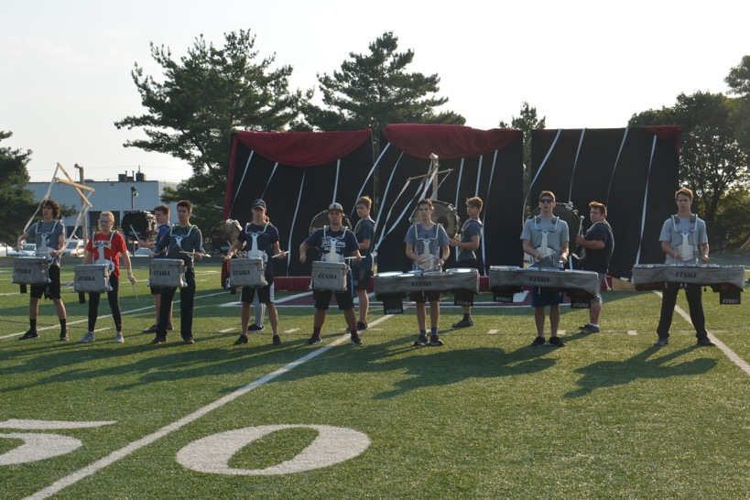
DCV Student Leaders
Drum Majors
Brass Captain
Section Leaders
Section Leaders
Drumline Captain
Guard Captain
Woodwind Captain
Section Leaders
Section Leaders
Section Leaders
Section Leaders
Section Leaders
Section Leaders
Section Leaders

Slide 18
Summer Rehearsals –
Always refer to Calendar – Dowling Catholic Bands (dchsband.org)!
June
Rookie Marching Boot Camp: Friday, June 2, 12:30 p.m. – 3:30 p.m.
All DCV: June 5-10 (refer to calendar for times)
ISU Marching Camps (optional for Colorguard, Drumline & Leadership only)
June 16 or 17 - https://www.music.iastate.edu/org/marching/academy
Refer to website for which camps offered which day

Slide 19
Summer Rehearsals (all on our calendar)
June
June 2 – Rookie marching camp
June 3-4 – Drumline camp
June 5-10 – Full DCV rehearsals
July
Family Week – No Events
July 23 – July 30
July/August
Band Camp (Mandatory):
July 31- August 11
Dress Rehearsal
August 12, 12 p.m. – 5 p.m.
Picnic & Parent Performance
August 12, 5:30 p.m. – 9 p.m.
Picture Day
August 15, 12 p.m – 4 p.m
DCV Evening rehearsal
Aug 17, 6:00 p.m. – 9 p.m.
DCV Drumline Stadium Rehearsal
Aug 21, 6:00 p.m. – 9 p.m.
DCV School schedule
Starts Aug 23, 7 a.m.

Slide 20
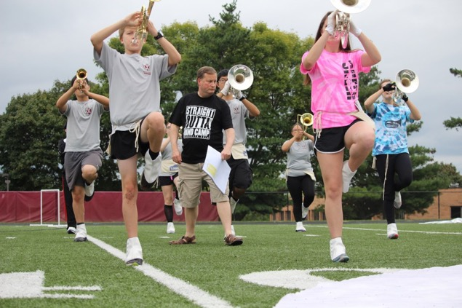
Band Camp Committee Chair: TBD
July 31 – August 12 (Rain or Shine)
Dowling Catholic High School
Bring lunch
Bring hats, sunglasses, sunscreen, etc.
Wear light-colored clothing and tennis shoes
Stay hydrated!!! Bring a very big water bottle (1 liter +)
Water will be available to refill the large jugs the students will bring to camp.
Medical volunteer on site each day

Slide 21
Marching Uniforms
New this year: “Performance top” – An alternative top that will be worn for competitions instead of the “Coat” that will fit the theme of the show.
What you don’t see …
DCV Wicking T-shirt
Athletic Shorts / Running Tights (you provide)
Black Crew/Long Socks (you provide)
Marching Shoes
All first year students will need to purchase marching shoes. Anyone wanting new ones for their child can purchase as well.
Full uniform
Primarily for football games
Plume
Shako
Gloves
Gauntlets
Coat
Bibs
Students arrive and depart performances in their wicking t-shirt, Performance Top, shorts, black socks and their own shoes.
The rest of the uniform is kept on the trailer or at the school.

Slide 22
Marching Uniform Purchases
Wicking T-shirts
Worn under marching uniform
Should order 2 shirts from the campus store
Performance Top
All members except Colorguard must purchase (around $60-80). Order info TBA
Marching Shoes
All “Rookie” members except colorguard must purchase

Slide 23
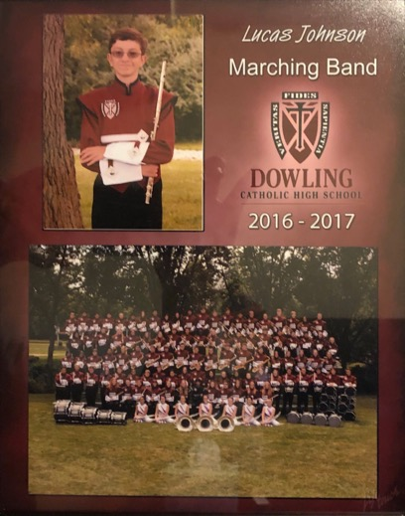
Vanguard Picture Day Committee Chair: Susie Fenton
August 15, 12 p.m – 4 p.m
Pictures taken by Vorland Photography
Full Band
Section Pictures
Individual Pictures
Sibling Pictures
Pictures will be available for purchase

Slide 24
Band Picnic & Vanguard Parent Performance Committee Chair: TBD
Sunday, August 13th @ 5:30 p.m. - Dowling Catholic HS Cafeteria and stadium complex
Picnic for All Band Families
Following the picnic, DCV will change into their uniforms and prepare for the performance
This year’s show will be unveiled to the families for the first time!
After the performance, families will be allowed on the field to take pictures

Slide 25
DCV Performance - Competition Schedule
Football:
September 8
September 15
October 6 (Homecoming)
October 20 – Pep Band Only
Competitions:
Sept 23 – Pella
Sept 30 – Band of America Iowa Regional (at Waukee NW)
Oct 7 - Valleyfest Showdown
Oct 14 - State Festival & Waukee Invitational – all day (Waukee)

Slide 26
Football Games
All of Dowling Catholic’s home football games are at Valley Stadium in West Des Moines (unless otherwise indicated)
Students need their own transportation to/from the home games
Some sections get together for a group meal before the game
Parents who want to watch the performances will need a ticket to the game*
* Volunteers (e.g. chaperones, roadies, media, uniforms, etc.) will be admitted for free

Slide 27
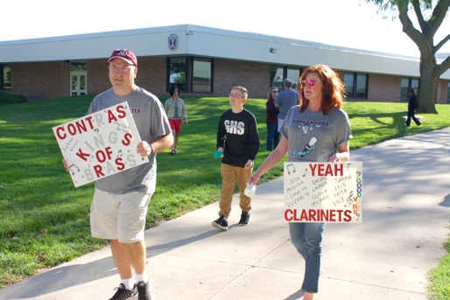
Marching Competitions
Specific schedules are included in the notes on the Google Calendar
Parents are encouraged to come out and support DCV at these competitions!!
A mix of times this coming year.
There is typically an admission charge for spectators.
Show your DCV pride … wear your Show Shirt!!!
Help us send DCV off before every competition by lining the sidewalk as they board the buses – signs and noisemakers are encouraged!!

Slide 28
DCV Mass & Dinner Committee Chairs: TBD
DCV celebrates Mass together at the Dowling Catholic HS Chapel before the Dinner
Dinner for all DCV members and families of the Senior members
Saturday, October 14th between State Contest and Waukee Invitational
Located in Dowling Catholic HS Cafeteria
Dinner honors the Senior members of Vanguard
Seniors share stories and receive a maroon feather for their plumes
Volunteers are need to help serve the dinner
Notes:
parent

Slide 29
Concert Season

Slide 30
Concert Uniforms Committee Chair: Kathleen Riessen
Boys
Tuxedos provided by the Band
You need to provide black socks and black dress shoes.
Tuxedo stored at your home during concert season
Shirt can be laundered; rest of the tux dry cleaned if needed
Girls
Dresses, shoes and pearls provided by Band
Pearls distributed before and collected after each performance
Shoes should not be worn to/from performances
Dresses stored at home
Dry clean, if needed
Notes:
parent

Slide 31
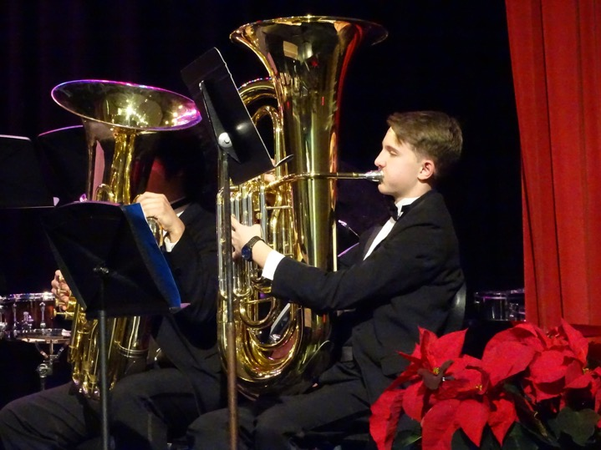
Christmas Concert Committee Chair: TBD
4 p.m. on Sunday, December 11
Dowling Catholic High School
Volunteers decorate the auditorium and prepare the concert program
Drive by caroling for brass choir, following - TBD
Notes:
parent

Slide 32
Jazz Performances
Fall Grade School Tour
World Food Prize Laureate Performance at the Capital
Pancake Breakfast Performance
DCHS Open House Performance
Performance at the Turner Jazz Center with the Drake University Jazz Band
Triton Jazz Festival
DCG Jazz Festival
Ron Battani Jazz Festival at Hoover High School,
Bluffs Jazz Festival
Spring Grade School Tour
Night of Jazz.
Dates for all but the grade school tours are on the band calendar.
Chaperones and Roadies will be needed
Notes:
Holland

Slide 33
Perry Band Olympics
An optional Solo/Ensemble festival
Saturday, February 17, 2024 (runs from early morning to late afternoon)
Perry High School in Perry, Iowa
Students are encouraged to sign-up for solos or small ensembles. Those in our chamber groups typically attend
Students need their own transportation to/from Perry
There is an admission charge for spectators.
Notes:
Holland

Slide 34
State Large Group Festival
Saturday, May 4, 2024
Location and Time TBD
Concert and Symphony Bands perform
Notes:
Holland

Slide 35
Chamber Concert Committee Chair: TBD
Solos & Ensembles
Invitation Only
Dowling Catholic High School
May xx, 2024
Volunteers prepare the concert programs and provide refreshments
Notes:
Holland

Slide 36
Other Competitions and Performances (optional)
All-State Band Auditions and festival
SCIBA Honor Band Auditions and festival
Drake Honor Band Festival
Cyclone Honor Band Festival
Drake Honor Jazz Band Festival
Notes:
Holland

Slide 37
Family Band Accounts

Slide 38
How You Pay for Band …
Band or Colorguard Participation Fee
Separate fee charged by Dowling Catholic
$225 per year for Band
$300 per year for Colorguard
Collected in October via your SmartTuition account
Goes towards the Band's overall budget for general operating expenses such as purchasing music, buying and/or repairing school-owned instruments, etc.
If applicable, 8th grade band scholarships applied to SmartTuition account (Not family band account)

Slide 39
How You Pay for Band …
Family Band (or Colorguard) Account
Streamlined way to pay for the individual expenses your student accrues for Band or Colorguard
One account per family
Receive statements in January and March of each year or upon request
Make payment through:
2022-2023 ONLINE PAYMENT
TBD - (All new incoming students & advance payments for ’23-’24)
Payment by debit or credit card will be assessed a processing fee of 2.85%

Slide 40
Family Band Accounts
Charges to Your Band Account
Marching and Concert Uniform
Gloves (except Drumline and Frontline)
Marching Shoes – 1st year only or if receiving new shoes
Concert Shoes (Girls) – 1st year only or if receiving new shoes
Concert Tuxedo Shirt (Boys)
Food and Transportation costs
Instrument rentals
Fees associated with band contests

Slide 41
Family Band Account Policies
Your account will be charged when the entire band has a function
Transportation is contracted in advance based on entire band being transported
Fees for solo/ensemble contests will be assessed if student signs up and then, drops out

Slide 42
Family Band Account Policies
Band Account must be at a $0 or positive balance at the end of each school year or your student will not be allowed to sign-up for Band/Colorguard for next year.
Accounts not paid by June 1st will receive $25 late fee on 1st of month starting in June until account is paid in full.
Positive Band Account balances roll forward into the next school year up through Senior year
At end of Senior year, positive balance is NOT automatically returned
Request remaining funds to be returned
Donate to another family band account
Money left in your account is used by Band Boosters

Slide 43
Family Band Accounts
New or have a $0 balance?
An initial deposit of $100-150 is recommended
Contact Information:
dchsbandtreasurer@gmail.com
Mail checks to:
DCHS Band Boosters
1400 Buffalo Road
West Des Moines IA 50265

Slide 44
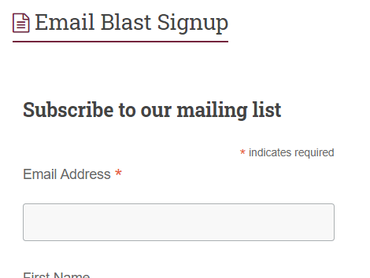
Communication
Website – dchsband.org
Emails (aka web-blasts) – signup online!
webmaster@dchsband.org
Twitter
@dowlingband
Facebook
Dowling Catholic Band Page
Dowling Catholic Color Guard Group
Google Calendar
Remind App (for students)

Slide 45
Communication
Band Booster Meetings
1st Thursday of the Month (September – May)
6:30 – 7:30 p.m.
Live & virtual
Minutes posted on band’s website

Slide 46
Band Registration (specific to Band)
Supplemental registration process for Band and Colorguard
Collects additional information for:
Medical information
food allergies/preferences
T-shirt sizes and shoe sizes (to order for new and ensure inventory for returning)
Link to our supplemental registration will go out via email
Please complete your student’s registration by 5/30 – on the dchsband.org website.

Slide 47
Additional Booster Activities

Slide 48
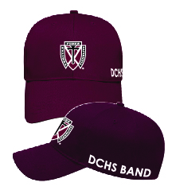
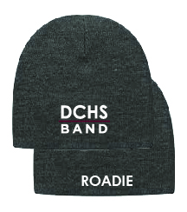
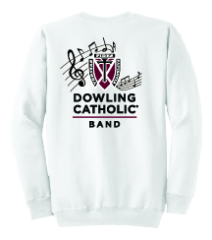
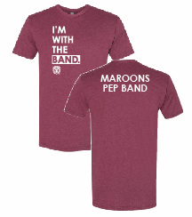
Band Apparel & Merchandise Committee Chairs: Leenie Rodriguez
Partnering with the Dowling Catholic Campus Store
Broadens our spirit wear offerings
Streamlines the ordering process
Pay with a credit card when you order
Orders can be shipped to you or picked up from the store
https://www.dchscampusstore.com/band/
Notes:
Jennie

Slide 49
Band Apparel & Merchandise
Commemorative Show Shirts & Patches
Show Shirts are optional; Order through the Campus Store
Parents - Wear them when you attend competitions, volunteer, etc.
Show patch provided to every student (charged to Band Account)
Notes:
Jennie

Slide 50
Marching Uniforms Committee Chairs: Kathleen Riessen
Organize and fit marching uniforms to students during August band camp
Coordinate alterations with Skeffington’s
Assist with minor fixes and alterations during marching season
Handling of plumes at performances
Ensure uniforms are inventoried at beginning/end of season

Slide 51
Chaperones Committee Chairs: Diana Givens – Marching Season Leenie Rodriguez – Post Marching & Jazz
Volunteers serve as chaperones for any trips on which our bands travel via bus
Accompany the students on the bus to and from the event
Chaperones must complete a background check and their VIRTUS training before assuming this role
Collect and package cookies donated by parents for each marching competition trip
Notes:
parent

Slide 52
Medical Committee Chairs: Deb Hummel
Volunteers with a medical background are present at every band event regardless of location
Medical volunteers attend every event with the students and travel on the bus with them for events outside of the DSM metro area.
Volunteers must complete a background check and their VIRTUS training before assuming this role
During Band Camp and marching events, medical volunteers will be in their DCV medic t-shirts so they are easily identified
Your student should be rested, well-fed, and hydrated throughout the entire marching season – Marching Band qualifies for the PE exemption for a reason!!!!
Notes:
Parent

Slide 53
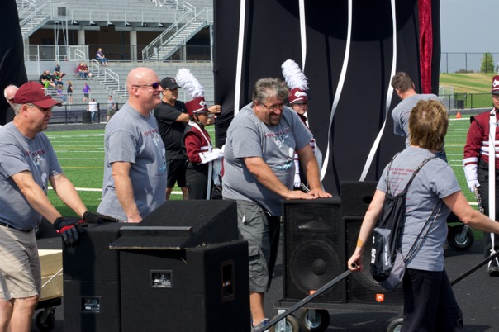
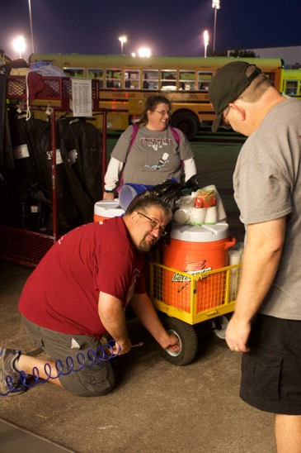
Roadies / Set Crew Committee Chair: Barry Cook & Bob Volp
Volunteers…
Build and maintain sets and props for show
Load and unload the trailer
Move props and equipment on/off the field during marching performances
Help with props on field during performances
Assist with loading, unloading, and setting up equipment for concerts, contests, etc.
Many hands make light work!
Notes:
parent

Slide 54
Food Committee Chair: Megan Aerisolphal
Organizes and serves the meals to DCV prior to marching competitions
Volunteers are needed to:
Help provide or prep food
Set-up the meal
Serve the meal
Clean-up after the meal
Notes:
parent

Slide 55
Recruitment Committee Chair: TBD
Uses targeted communications, social media and events to create awareness and favorability for the DCHS Band program
Helps to create an environment in 7/8th grade students:
Become interested in DCHS band
Desire, receive and actively seek more information about DCHS band
Demonstrate interest in joining band
Ultimately register for and participate in band at DCHS
Develop and/or deepen relationships between DCHS Directors and students with middle school band students
Maintain regular contact with middle school parents and band teachers. Highlight band activities, accomplishments, individual and small group achievement
Coordinate with DCHS Marketing Staff to include band in DCHS communications to the the Dowling Catholic community

Slide 56
Recruitment
Staffs Band’s informational tables at November 3rd Open House
Greets elementary students and parents at All-City Band events in September and January
Represents the DCHS Band at middle school concerts and events
Helps organize Band Bash (TBD) – the week-long mini-band camp for middle school students at Dowling (July 26-30)

Slide 57
Media Committee Chairs: John Seda
Takes photos and videos
From band camp through the Spring Concert, committee members are on the sidelines and near the stage at every performance
Zenfolio – dowlingband.zenfolio.com
Password-protected, web-based photo/video storage and sharing site
Free downloads
Volunteers are needed to take pictures – any type of camera or phone is fine – and videos.

Slide 58
Media Committee Chair: TBD
Manages the DCHS Band website – www.dchsband.org
Responsible for the Dowling Band Social Media
Twitter Account (@dowlingband)
To receive updates on your phone, send a text message to 40404 with this message: follow @dowlingband
Facebook Page – Dowling Catholic Band

Slide 59
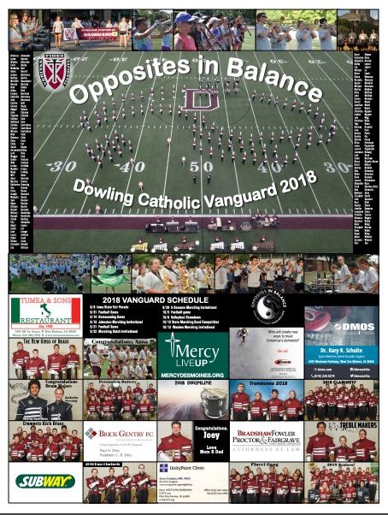
Band Poster Committee Chair: TBD
Band Poster (similar to athletic team posters)
Sell ads to raise money for the band boosters
Families can purchase ads for Seniors, Sections, Siblings, etc.

Slide 60
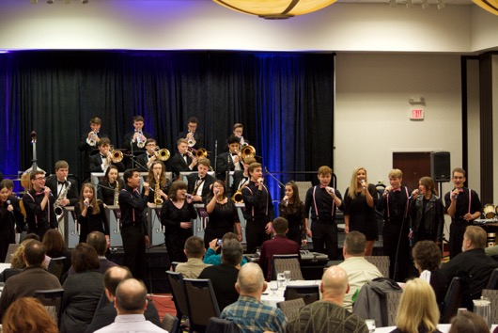
Deep Maroon Serenade Committee Chair: Susie Fenton
Band Program’s Major Fundraiser – the only one!
2024’s Fundraising Goal = $x,000
Proceeds benefit the Band Program
Donation requests are made during the event
2024 Date/Location TBD
Symphony Band, Concert Band, and Chamber Groups Perform
“Band Aid” fundraising letter campaign follows Deep Maroon Serenade

Slide 61
Spring Concert & Awards Committee Chair: Leenie Rodriguez
Afternoon of Sunday April 28, 2024
Dowling Catholic High School
Volunteers prepare the concert program and organize the band awards
Notes:
Holland/Ann

Slide 62
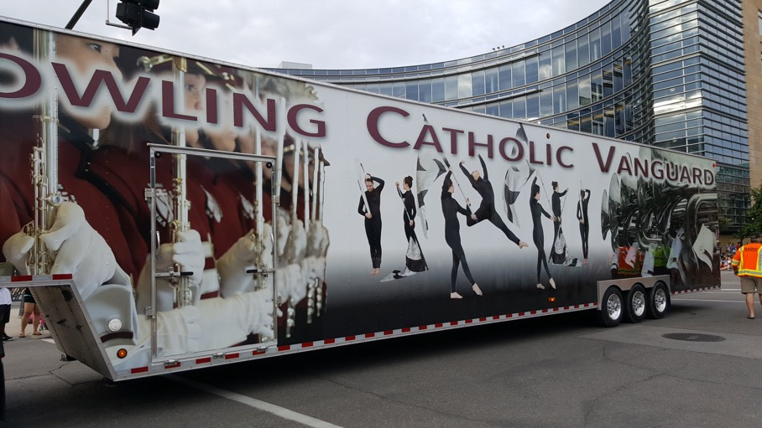
Questions? Thank you for coming!!

